Slide 1
Applications of machine learning for anomaly detection
By: Daniel Simpson
Notes:
This was a project I designed to explore applications of supervised and unsupervised machine learning techniques for anomaly detection. The project explores multiple machine learning algorithms used in anomaly detection today and compares them across multiple different datasets. The overall idea was to decide how a newly formed department could benefit from using machine learning to flag anomaly values, and as a case study credit card fraud as an anomaly is used for the supervised part of this project.

Slide 2




Project Design
Unlabeled New Data
Unsupervised model
Tune Model
Labeled data
Fraud Department
Training
Supervised model
2
Notes:
First, I focus on how data coming into a department could be filtered using an unsupervised machine learning algorithm.
Once the department starts to accumulate labeled data this can be used to tune the model.
Eventually once enough data is built up, we can use a supervised model for more accurate results and thus we can eventually eliminate the unsupervised part of the problem.

Slide 3
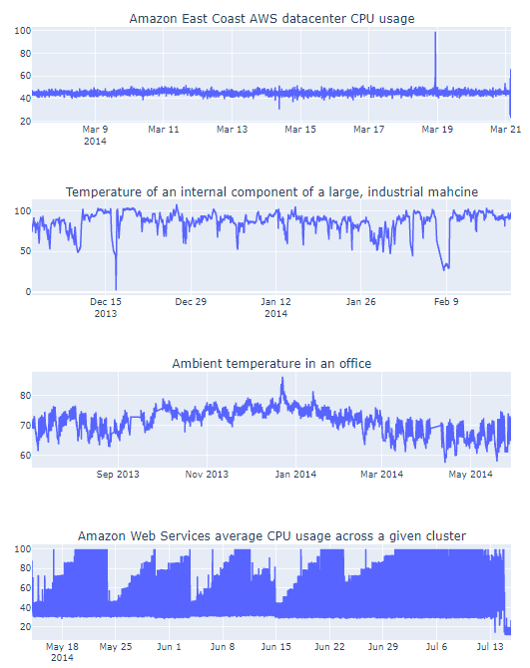
Unsupervised data
The Numenta Anomaly Benchmark
Methodology
Feature Engineering
Dimensionality Reduction using PCA
K-means Clustering
Gaussian Naïve Bayes with Clusters
Isolation Forest
One Class Support Vector Machine
Deep Learning:
LSTM
Outlier Fraction = 0.001
1
NAB
Notes:
The first part of the project focuses on 4 datasets collected from the Numenta Anomaly Benchmark pack on GitHub. These are real world datasets known to contain anomalies but lack any form of labeling. The first dataset is CPU usage from an East Coast AWS datacenter. The second dataset is the temperature of an internal component to an industrial machine and has multiple anomalies that which were known to cause the machine to shut down. The third dataset is the ambient room temperature for an office space and contains anomalies for when the office thermometer stopped working. And the fourth dataset is the average CPU usage across a cluster of AWS servers containing anomalies that eventually crashed all the servers in the cluster, which we can see at the end here.
For each of these, feature engineering is applied to extract useful information to improve the machine learning algorithms performance. Dimensionality reduction with principal component analysis is utilized when using the k-means clustering algorithm. Once clusters are established the distance to the centroids can be used for anomaly detection, along with applying a gaussian distribution to each cluster for anomaly detection. Isolation Forest, Support Vector Machine, and Long-short term memory neural networks are also tested in this project.
All of these methods require an outlier fraction to determine the number of anomalies detected, and a fraction of 0.001 was used throughout.

Slide 4
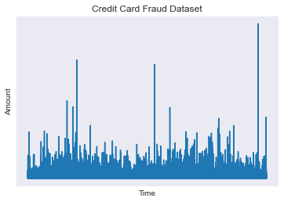
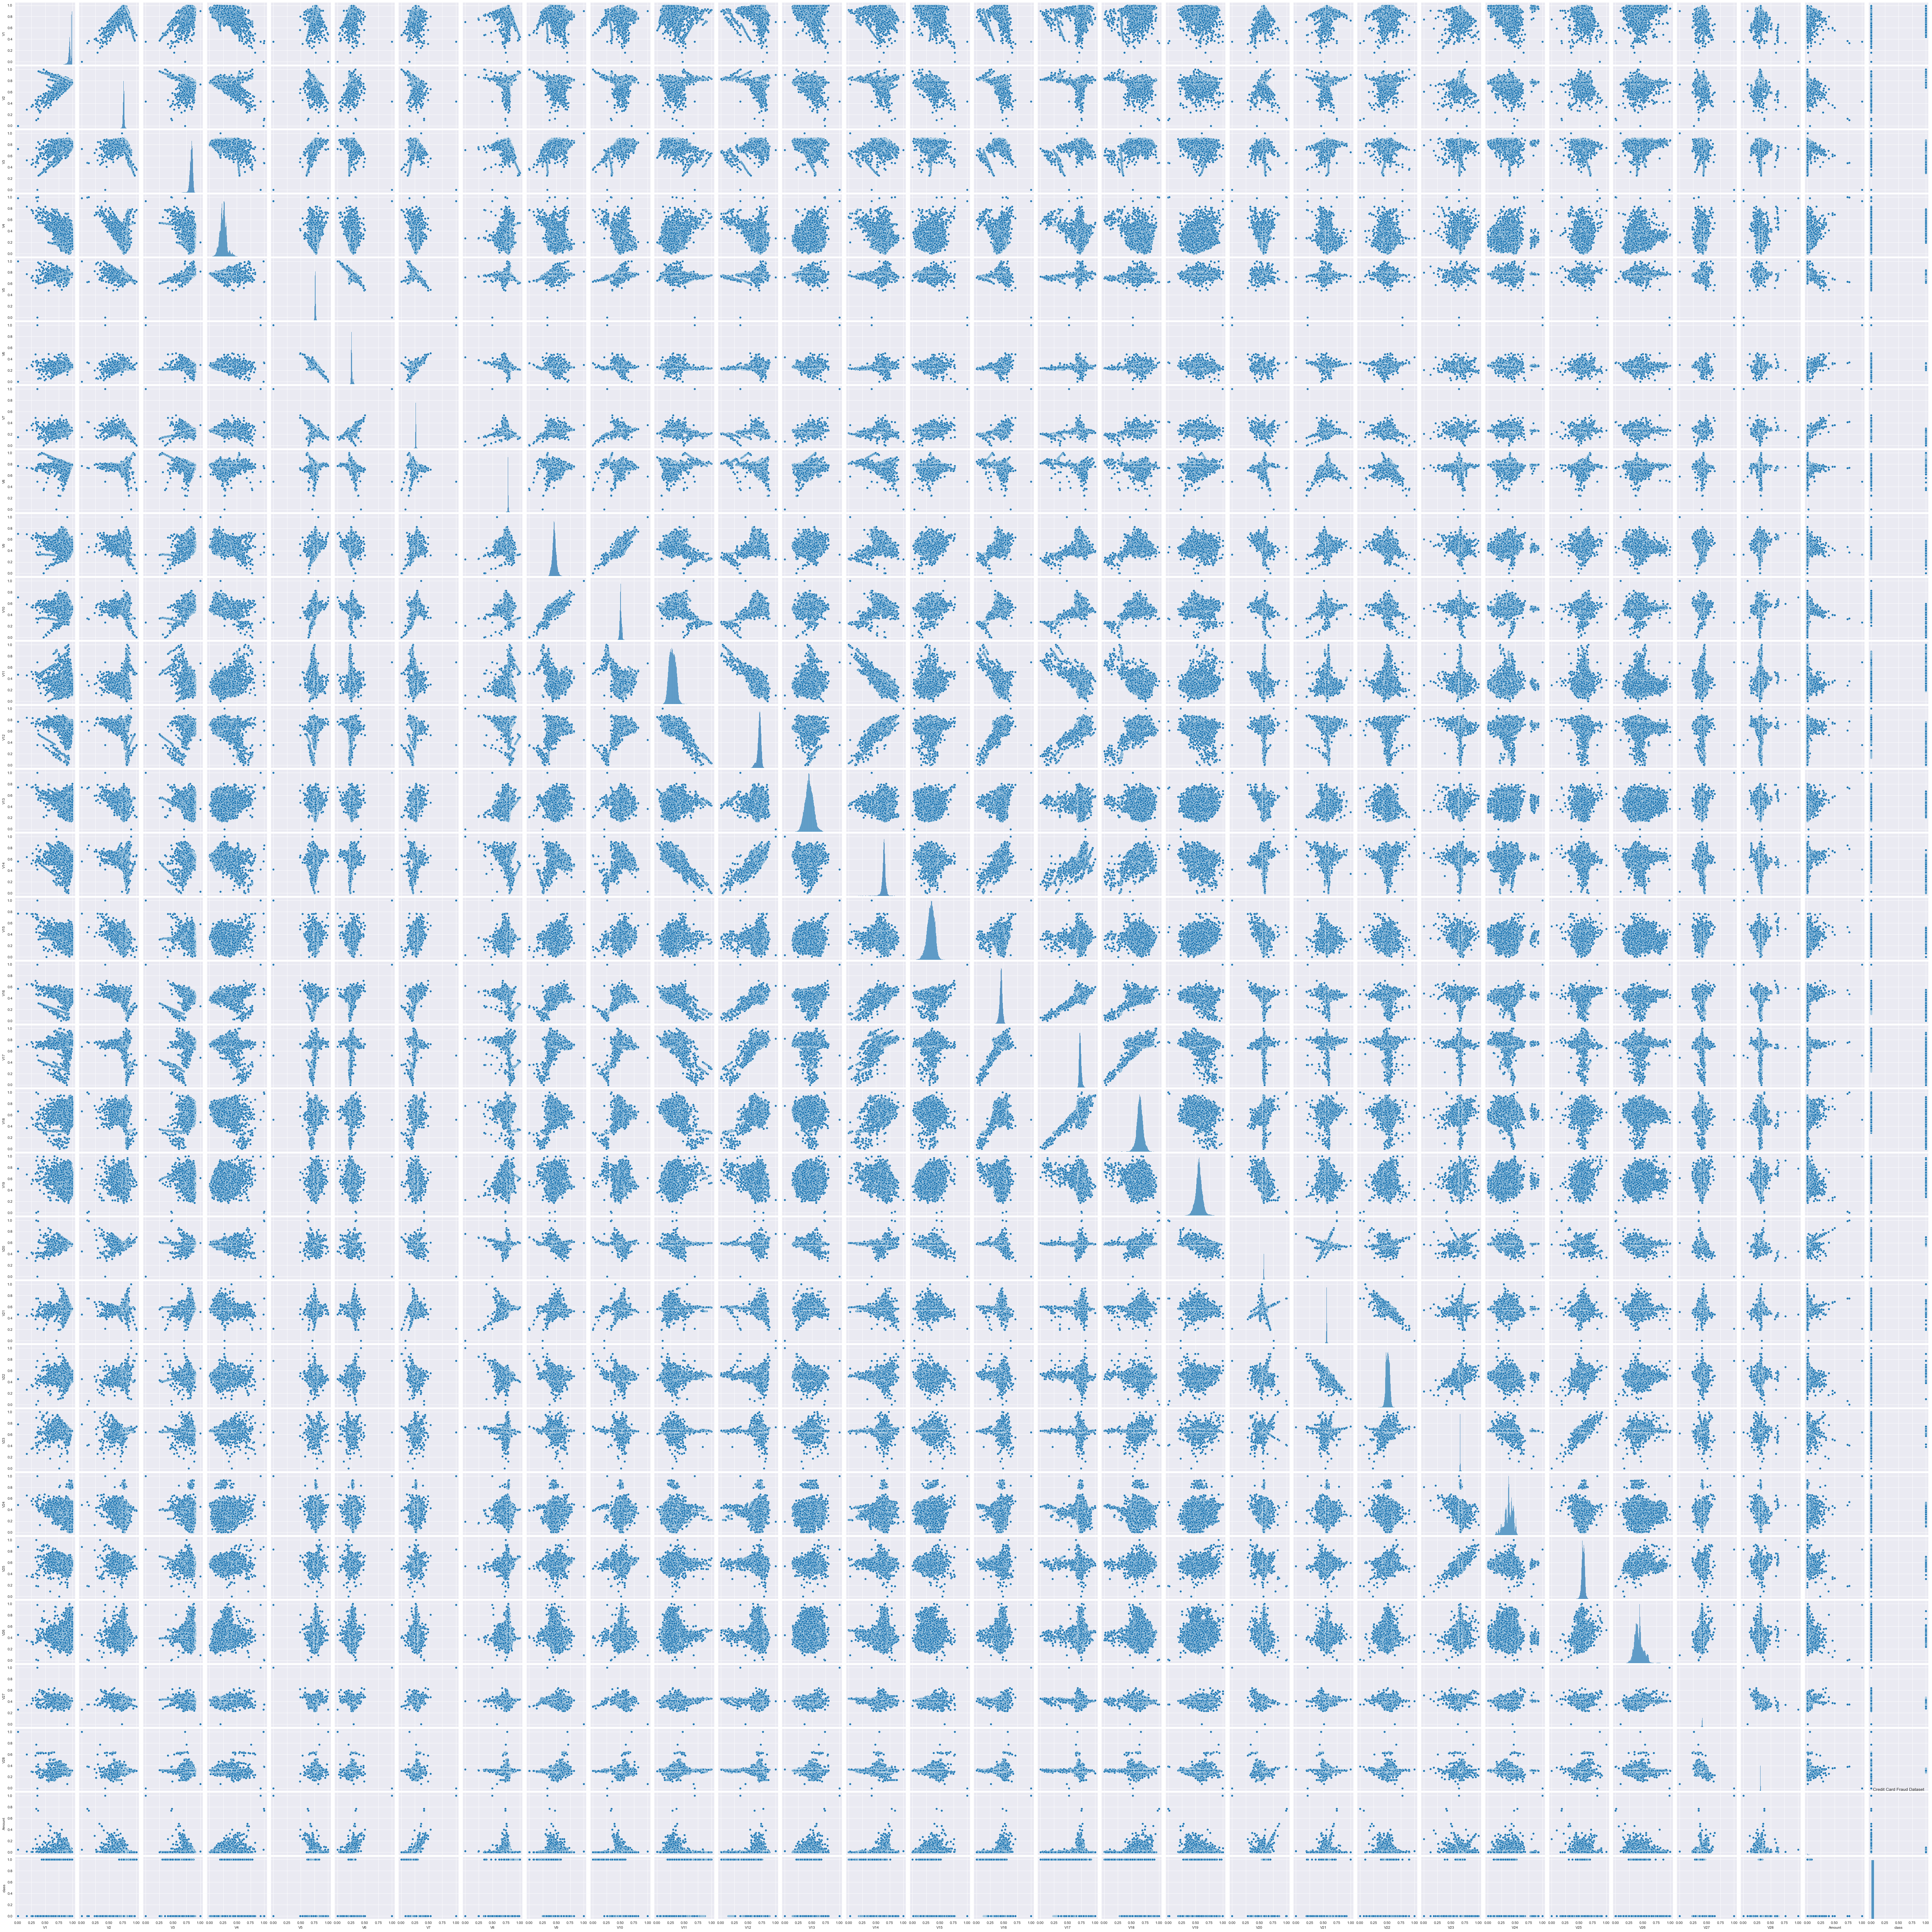
Supervised Data
Methodology
Credit Card Fraud Dataset
Applications of unsupervised techniques
70%/30% - Train/Test split
Models
Logistic Regression
KNN
SVC
Decision Tree
Neural Network
XGBoost
Hyperparameter Tuning
Grid Search
2
Anomaly Detection Datasets
Notes:
The second part of the project is focused on supervised learning, using a credit card purchases dataset. This data contains 28 additional features for each purchase and has known labeled occurrences of fraud. It can also be found online at GitHub, and multiple papers have cited this dataset for anomaly detection work.
The same techniques used on the previous datasets are performed and accessed. Next supervised models will be trained on 70% of the data and tested on the remaining 30%. The models trained include Logistic Regression, K-nearest neighbor, support vector classifier, decision tree, neural network, and gradient boosted decision tree.
Once the best model is identified, grid search techniques are applied to tune hyperparameters of the model for improved performance.

Slide 5
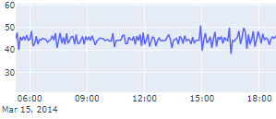
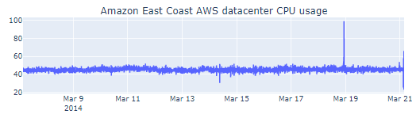
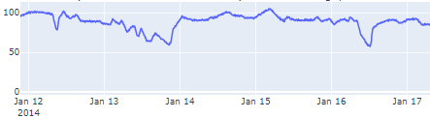
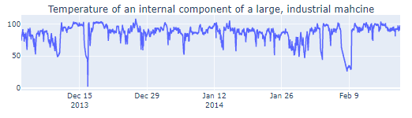
Feature Engineering
Amazon East Coast AWS Datacenter CPU usage:
Minutes
Hours
Day
Temperature of Industrial Machine component:
Hours
Day
|Unsupervised|
Notes:
For feature engineering I simply looked at the data on different levels to identify potential patterns. For the East Coast AWS datacenter there was a lot of fluctuation down to the minute, so minutes, hours, and days were used for additional features. There was less fluctuation for the industrial machine component, so I simply used hours and days.

Slide 6
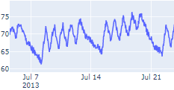
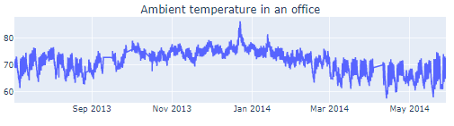
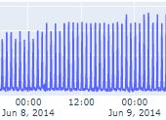
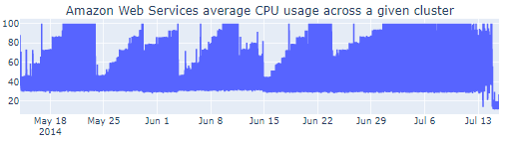
Feature Engineering
Ambient temperature in an office:
Hours
Day
Working Hours
Weekday
AWS Average CPU usage across given cluster:
Minutes
Hours
Day
Weekday
|Unsupervised|
Notes:
For the office space temperature, there was a clear pattern day to day during working hours, along with weekends, so those features were chosen along with day and hour. The AWS cluster contain patterns on the minute scale along with weekly patterns, so minutes, hours, day and whether it was a weekday were all used for features.

Slide 7
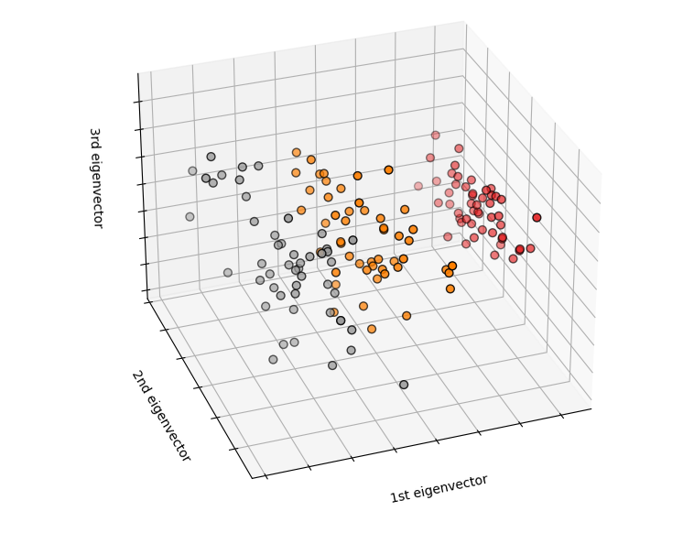
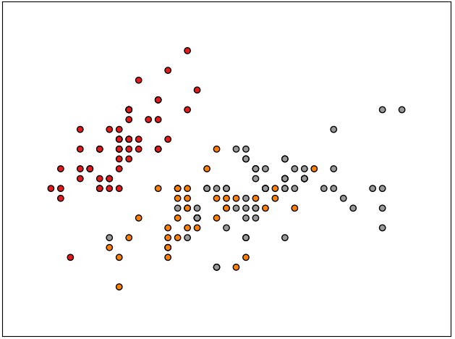
K-means and Principal Component Analysis
PCA
3
PCA Visuals
|Unsupervised|
Notes:
For the k-means clustering algorithm dimensionality reduction techniques help the algorithm perform better, so I first applied principal component analysis. This is simply a means to reduce the data down to lower dimensions while preserving a lot of the information. All of the datasets were reduced down to their first and second principal features.

Slide 8
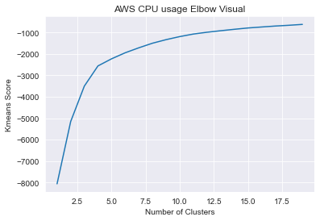
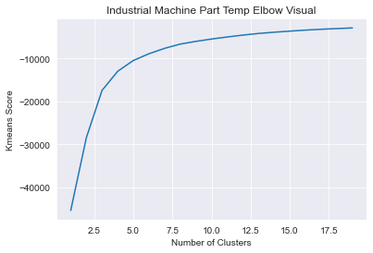
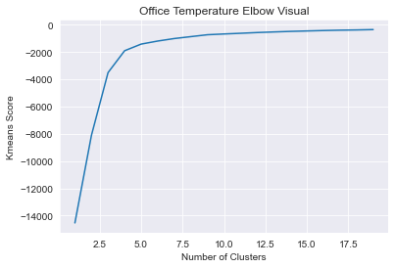
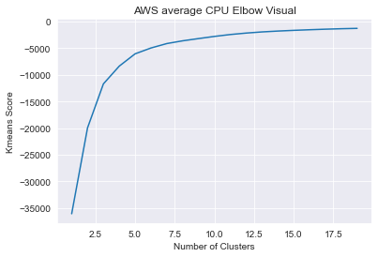
K-means Clustering
Clusters = 10
Clusters = 8
Clusters = 5
Clusters = 5
|Unsupervised|
Notes:
Once the data was reduced down the number of clusters had to be chosen. Ideally when conducting the k-means analysis, the number of clusters can be experimented with. It is convention to look for the lowest number of clusters that also results in a k-means score close to 0, preferably right before the score levels off. This is oftentimes referred to as the elbow method. For each of these datasets I chose the cluster values labeled. Since this part of the project is completely unsupervised, I did not spend much time playing with different cluster values.

Slide 9
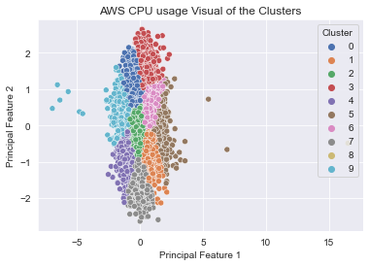
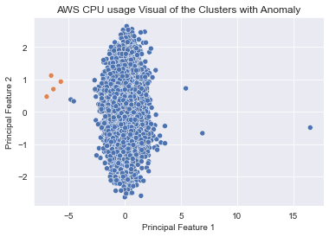
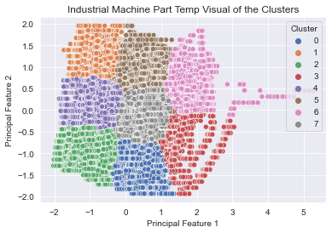
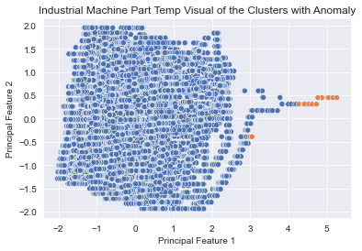
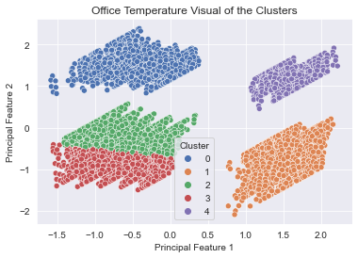
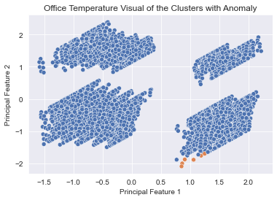
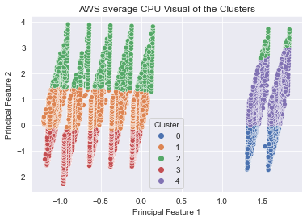
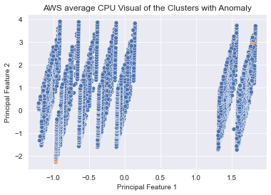
K-means Clustering
AWS CPU
Industrial Machine Part
Office Space Room Temperature
AWS Cluster
|Unsupervised|
Notes:
Here are each of the datasets viewed within their clusters which I designed using seaborn and matplotlib. The multi-colored images show each cluster, while the images to the right show the anomalies detected using the centroid distance.

Slide 10
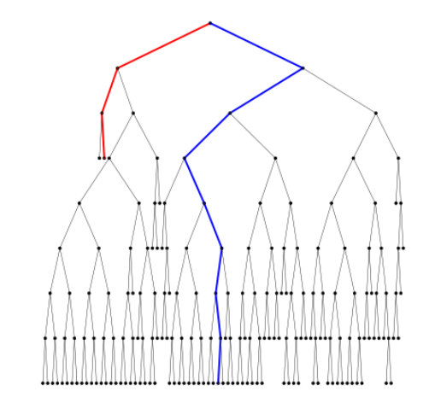
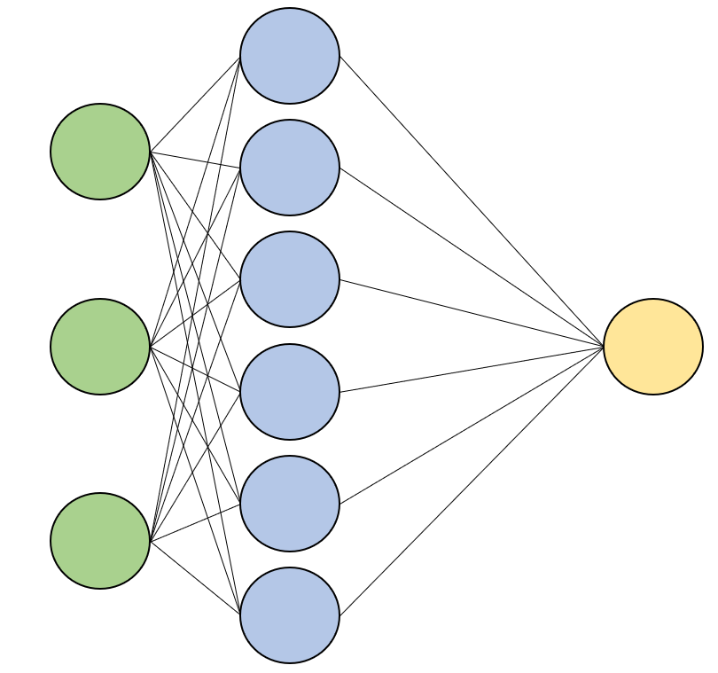
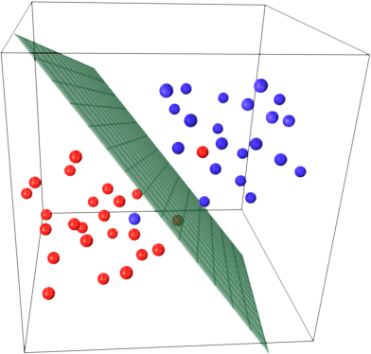
Isolation Forest | SVM | Neural Network
4
Hariri, et al. (2018)
|Unsupervised|
Notes:
The other three algorithms used are Isolation Forest, SVM, and neural networks. As you can see the isolation forest is a variation of a decision tree originally proposed in 2008. Support Vector Machines utilize all the features as dimensions and attempt to divide the normal and anomaly data by a high dimensional plane. And Neural Networks of course use multiple layers and nodes with activations to determine the best fit function for the model. Now let’s jump into the results of each algorithm.

Slide 11
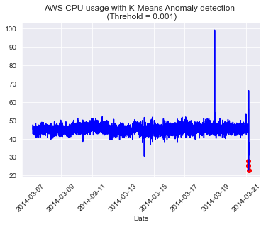
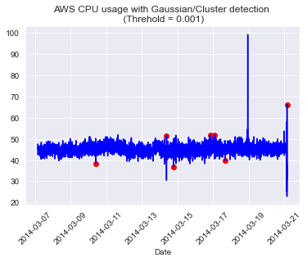
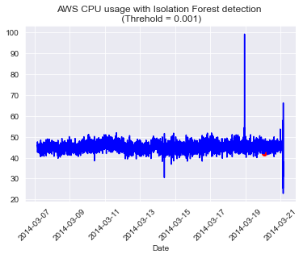
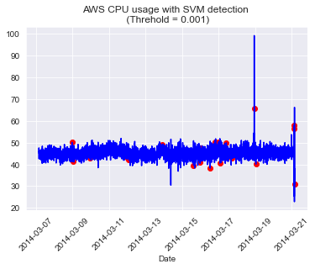
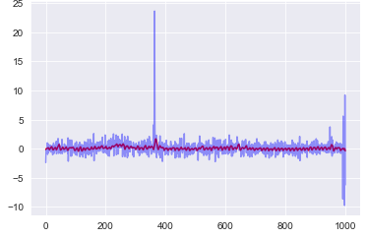
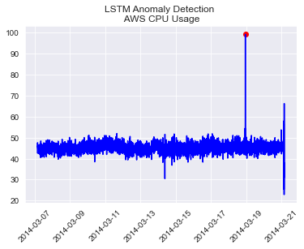
AWS CPU
K-means centroid
Gaussian
Isolation Forest
Anomalies Detected: 4
Anomalies Detected: 8
Anomalies Detected: 2
SVM
Neural Network
Anomalies Detected: 26
Anomalies Detected: 2
|Unsupervised|
Notes:
Here we have the first data set with the anomalies found by each method marked in red. the SVM model has predicted the most anomalies while the Isolation Forest and the LSTM network are predicting the least. The reason the LSTM model has two visuals is so you can see the function predicted by the neural network which can be seen in the first visual, and any values that fall too far from this predicted function will be flagged as anomalies, as shown in the second visual.

Slide 12
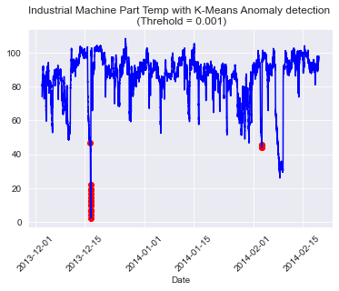
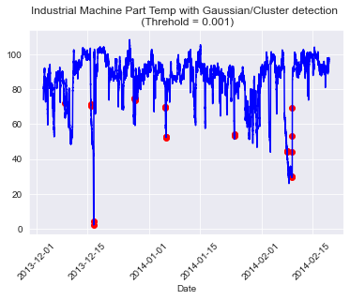
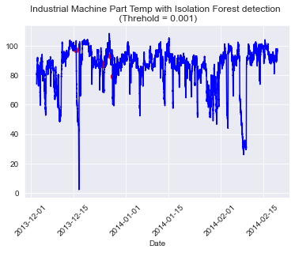
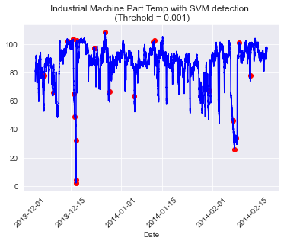
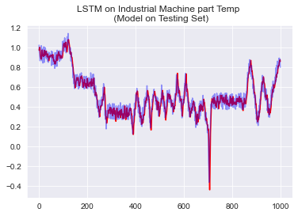
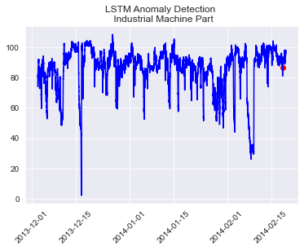
Industrial Machine
K-means centroid
Gaussian
Isolation Forest
Anomalies Detected: 22
Anomalies Detected: 28
Anomalies Detected: 8
SVM
Neural Network
Anomalies Detected: 29
Anomalies Detected: 1
|Unsupervised|
Notes:
For the second dataset the K-means clustering strategies are predicting almost as many anomalies as the SVM, while the neural network is once again predicting the least amount of anomalies.

Slide 13
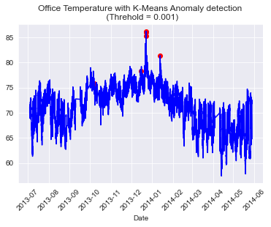
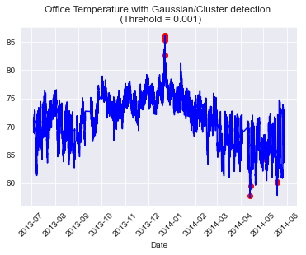

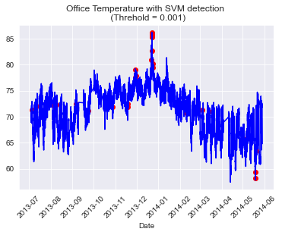
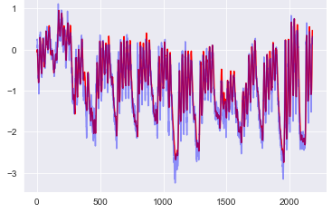
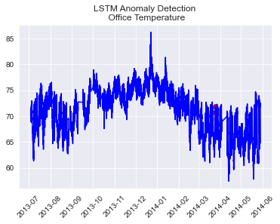
Office Space Temperature
K-means centroid
Gaussian
Isolation Forest
Anomalies Detected: 7
Anomalies Detected: 10
Anomalies Detected: 8
SVM
Neural Network
Anomalies Detected: 36
Anomalies Detected: 2
|Unsupervised|
Notes:
The third dataset shows roughly the same pattern, with the SVM producing the most anomalies and the neural network producing the least.

Slide 14
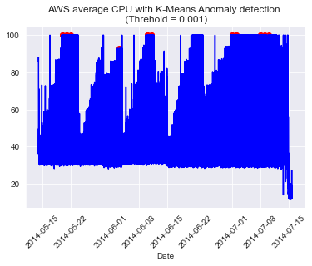


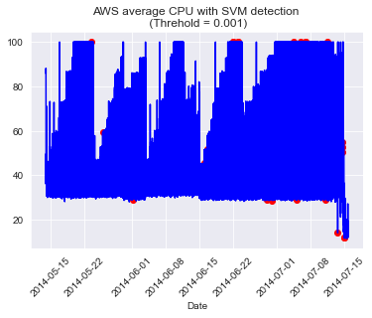
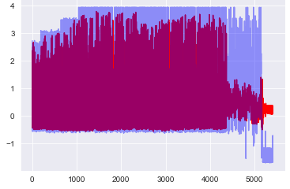
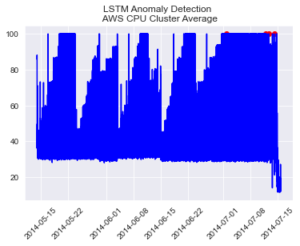
AWS Server Clusters
K-means centroid
Gaussian
Isolation Forest
Anomalies Detected: 19
Anomalies Detected: 23
Anomalies Detected: 8
SVM
Neural Network
Anomalies Detected: 48
Anomalies Detected: 5
|Unsupervised|
Notes:
And the final unsupervised dataset exhibits similar results. For all of these models if we adjust the outlier fraction or threshold value, we would increase the number of anomalies detected. This value is open to interpretation and should be specific to the data being observed. For this I simply used a threshold value of 0.001 but one might find a higher threshold value works better for certain datasets.

Slide 15
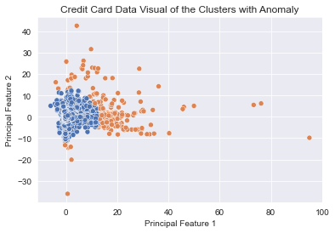



Credit Card Fraud Dataset
Clusters = 5
Outlier Fraction = 0.001
Outliers tested = [0.001, 0.01, 0.1]
Clusters tested = [5, 6, 7, 8, 9, 10]
|Unsupervised and Supervised|
Notes:
For the supervised part of this project, I applied the same algorithms as before, but used the labeled data to help guide the optimization of the models. The idea was that if there was only limited data available this technique could be used in the early stages of a fraud detection system to decide which machine learning technique to use. For the clustering algorithm I experimented with the outlier fraction and cluster numbers as listed.
As you can see, 5 clusters at 0.001 outlier fraction although it detects multiple anomalies, none of them are correctly labeled fraud values.

Slide 16



K-means on CC Data
Outlier Fraction = 0.1
Clusters = 7
|Unsupervised and Supervised|
Notes:
But when the clusters were set to 7, and the outlier fraction set to 0.1, the model was catching a lot more fraud instances. The downside is clearly that we are missing 155 instances of fraud and flagging 2,511 normal transactions as fraud.

Slide 17




Isolation Forest on CC Data
Outliers tested = [0.1, 0.01, 0.02, 0.03, 0.04, 0.05, 0.001]
Increasing the Outlier Fraction
Increases fraud correctly identified
Decreases fraud incorrectly identified
Increases no fraud incorrectly identified
|Unsupervised and Supervised|
Notes:
For the isolation forest only the outlier fraction was adjusted, and as expected the larger the fraction, the more cases of fraud caught but the model also labeled a substantial amount of normal transactions as fraud. This would easily overwhelm any fraud department if the outlier fraction was set too high.

Slide 18




SVM on CC Data
Outliers tested = [0.1, 0.01, 0.02, 0.03, 0.04, 0.05, 0.001]
Increasing the Outlier Fraction
Increases fraud correctly identified
Decreases fraud incorrectly identified
Increases no fraud incorrectly identified
|Unsupervised and Supervised|
Notes:
The same pattern is seen for the SVM model. It would be the prerogative of the fraud department to identify whether to deal with more mislabeled fraud cases or catch less actual fraud cases in the early stages.

Slide 19
Supervised Models on Credit Card Dataset
Train Set (k-fold=5)
Model | Accuracy Score
Logistic Regression | 99.899%
K-nearest neighbors | 99.945%
Support Vector | 99.938%
Decision Tree | 99.911%
Neural Network | 99.937%
XGBoost | 99.954%
Test Set
Model | Accuracy Score
Logistic Regression | 99.910%
K-nearest neighbors | 99.953%
Support Vector | 99.936%
Decision Tree | 99.923%
Neural Network | 99.938%
XGBoost | 99.968%
|Supervised|
Notes:
The final part of this project applied supervised machine learning algorithms to the labeled dataset. The dataset was broken down into 70% training size for each model, and accuracy of the model is tracked on the training set using the average of the 5-fold cross-validation scores, and on the testing set. As you can see all of the algorithms performed quite well. When looking passed just the accuracy we get a clearer picture of which model would suite this problem best.

Slide 20



Logistic Regression
 | Train | Test
Recall Score | 53.371% | 52.9412%
Precision Score | 87.558% | 84.7059%
F1 Score | 66.318% | 65.1584%
Accuracy | 99.903% | 99.9099%
k-nearest neighbor
 | Train | Test
Recall Score | 78.933% | 79.412%
Precision Score | 94.932% | 90%
F1 Score | 86.196% | 84.375%
Accuracy | 99.955% | 99.953%
Support Vector Classifier
 | Train | Test
Recall Score | 78.933% | 83.088%
Precision Score | 85.152% | 77.931%
F1 Score | 81.924% | 80.427%
Accuracy | 99.938% | 99.936%
|Supervised|
Notes:
Ideally, we would want to increase the True Positive values, those which are in the bottom right corner of the confusion matrices, while also reducing the False Positive values, those which are in the top right corner. Reducing the False Negatives would be an added benefit but isn’t a priority as letting a few mislabeled fraud cases could be manually sorted quite easily by the fraud department.
Other scoring metrics we can use are Precision, Recall, and F1.
The Precision score is calculated using the True Positive and False Positive, shown in red. The Recall score is calculated using the True Positive and False Negative shown in purple, and the F1 score is a combination of both, shown in green. So, these are the indicators we will be looking at instead of the accuracy score.

Slide 21



Decision Tree
 | Train | Test
Recall Score | 100% | 77.206%
Precision Score | 100% | 75%
F1 Score | 100% | 76.087%
Accuracy | 100% | 99.923%
XGBoost
 | Train | Test
Recall Score | 100% | 84.559%
Precision Score | 100% | 95.041%
F1 Score | 100% | 89.494%
Accuracy | 100% | 99.968%
Neural Network
 | Train | Test
Recall Score | 74.719% | 74.265%
Precision Score | 88.08% | 84.874%
F1 Score | 80.851% | 79.216%
Accuracy | 99.937% | 99.938%
XGBoost has the highest Recall, Precision, and F1 score for all models.
|Supervised|
Notes:
When looking at all the models we can see that the XGBoost has the highest Precision score, and as an added bonus has the highest F1 score. Since this model is performing so well, we will use XGBoost for the hyperparameter tuning, to see if we can increase performance.

Slide 22
Hyperparameter Tuning XGBoost
min_child_weight – [1, 5, 10]
Minimum sum of instance weight (hessian) needed in a child
gamma – [0, 0.5, 1]
Minimum loss reduction required to make a further partition on a leaf node of the tree
subsample – [0.8, 1]
Ratio of the training instances
colsample_bytree – [0.6, 0.8, 1]
Fraction of columns to be subsampled
max_depth – [3, 4, 5, 6]
Maximum depth of the tree
Validate using stratified k-fold cross validation
(5 folds)
Credit Card Fraud Dataset
Randomize
Train
Test
Dev
Train
Test
Train
Dev
Train
Test
Train
Dev
Train
Test
Train
Dev
Test
Train
Dev
Optimize using F1 and Precision scores
5
XGBoost Parameters
|Supervised|
Notes:
The 5 hyperparameters that would be adjusted are listed here. The first two, min_child_weight and gamma help determine when a leaf node in the tree makes a split. The second two, subsample and colsample_bytree determine how much of the data is used during the training iterations. And the final hyperparameter max_depth determines the maximum number of levels the tree can have. Using grid search, every combination of these hyperparameters were tested on the XGBoost algorithm.
For training and testing purposes, a development set was first removed from all of the data for validation after the grid search. The remaining data was divided into 5 sections or folds, training the model with those specific hyperparameters on four out of five of the folds, and testing the model on the remaining fold. This was repeated 5 times so that each fold was used for testing, and the average of all five was used to access that particular model’s performance.
The grid search was performed twice, once using the F1 score as an optimizer, and a second time using the Precision score.

Slide 23




Results
Optimized for F1 score
 | Dev | All Data
Recall Score | 83.66% | 94.512%
Precision Score | 98.462% | 99.572%
F1 Score | 90.459% | 96.976%
Accuracy | 99.968% | 99.99%
Hyperparameter
min_child_weight | 1
gamma | 1
subsample | 0.8
colsample_bytree | 1.0
max_depth | 4
Optimized for Precision score
 | Dev | All Data
Recall Score | 80.392% | 93.293%
Precision Score | 96.85% | 99.136%
F1 Score | 87.857% | 96.126%
Accuracy | 99.96% | 99.987%
Hyperparameter
min_child_weight | 1
gamma | 1
subsample | 1.0
colsample_bytree | 0.6
max_depth | 5
|Supervised|
Notes:
In the end we can see the specific combination of hyperparameters found from each grid search, and the resulting confusion matrix when using the model on the unseen development set.
Optimizing for the F1 score seems to have produced the best model as the True Positives is higher, and the False Positives and False Negatives are lower.
And as expected we can see the top model has a higher precision and F1 score as well.

Slide 24


Conclusion
Unlabeled New Data
K-means Clustering
Tune Model
Labeled data
Fraud Department
Training
XGBoost Model
Notes:
So, in conclusion when setting up an initial fraud department with zero labeled data, we’d most likely wish to use K-means clustering as it was able to detected a large majority of the fraud transactions without overwhelming the fraud department with incorrectly labeled fraud. The threshold value would need to be adjusted according to the fraud departments prerogative.
Once a dataset of labeled fraud transactions starts to build up, this can be used to identify True Positive and False Positive predictions of the model, allowing for additional tuning of the outlier fraction.
And once we have a large enough dataset with enough labeled fraud transactions, we can train the XGBoost model with the specified hyperparameters, for optimal fraud detection. As more data is collected more data can be used for training, improving the performance of the model over time.

Slide 25

Additional Considerations
Computation time as a factor
Unsupervised vs supervised models
Training vs Testing time
Greedy algorithms
Grid search vs Random search
k-fold cross-validation
Other algorithms for anomaly detection
Notes:
Some additional considerations to factor in include Computational time, the use of Greedy algorithms, and other possible anomaly detection algorithms.
When it comes to computational time the K-means algorithm performed the slowest during the training, while logistic regression trained the fastest. If we are continuously re-training our models this should be taken into consideration for which model, we choose. Once the model is designed prediction time should be considered when deciding how often and when new streams of data are tested.
Depending on the size of the data, the use of greedy algorithms such as grid search could be a major hinderance to progress, so other methods such as random search for hyperparameter searching could be utilized.
And finally, there are numerous anomaly detection algorithms available, given more time and resources these other algorithms could be explored as they might have better results dependent on the data.

Slide 26
References
The Numenta Anomaly Benchmark (NAB)
https://github.com/numenta/NAB
Anomaly Detection Datasets
https://github.com/GuansongPang/anomaly-detection-datasets
Principal Component Analysis Visual
https://scikit-learn.org/stable/auto_examples/datasets/plot_iris_dataset.html#sphx-glr-auto-examples-datasets-plot-iris-dataset-py
Hariri, S., Kind, M., & Brunner R. (2018). Extended Isolation Forest. Cornell University: arXiv.org.
XGBoost Parameters
https://xgboost.readthedocs.io/en/latest/parameter.html#

Slide 27


Full list of Hyperparameters:
Optimized for F1 score
Full list of Hyperparameters:
Optimized for Precision score

